Slide 1
CS4038
DATA MINING
LECTURE # 19
SPRING 2024
FAST – NUCES, CFD CAMPUS
AYESHA LIAQAT
ayesha.liaqat@nu.edu.pk

Slide 2
TODAY’S TOPICS
Data similarity & dissimilarity measures (continued)
Cluster analysis: basic concepts & applications

Slide 3
DATA PROXIMITY MEASURES
SIMILARITY AND DISSIMILARITY METHODS

Slide 4
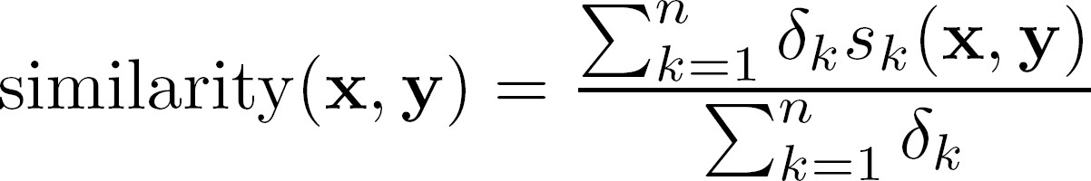
GENERAL APPROACH FOR COMBINING SIMILARITIES/DISSIMILARITIES
Sometimes attributes are of many different types, but an overall similarity measure is needed.
For the k^{th} attribute, compute a similarity, s_{k}(x, y) or d_{k}(x, y), in the range [0, 1].
Define an indicator variable, δ_{k}, for the k^{th} attribute as follows:
δ_{k} = 0 if the k^{th} attribute is an asymmetric attribute and both objects have a value of 0, or if one of the objects has a missing value for the k^{th} attribute
δ_{k} = 1 otherwise
Compute combined similarity/dissimilarity using:

Slide 5
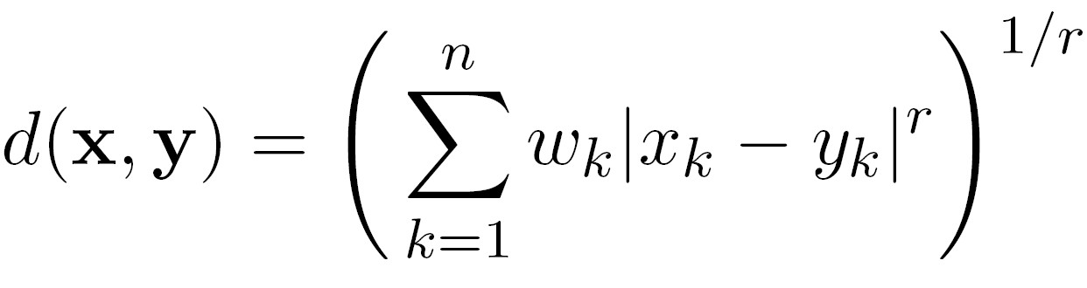
USING WEIGHTS TO COMBINE SIMILARITIES/DISSIMILARITIES
Sometimes we may not want to treat all the attributes as the same.
Use non-negative weights 𝜔_{𝑘}
𝑠𝑖𝑚𝑖𝑙𝑎𝑟𝑖𝑡𝑦 𝐱, 𝐲 =
∑𝑛
𝜔_{𝑘}#_{𝑘}𝑠_{𝑘}(𝐱,𝐲)
𝑘=1
∑𝑛
𝜔_{𝑘}#_{𝑘}
𝑘=1
Can also define a
weighted form of distance

Slide 6
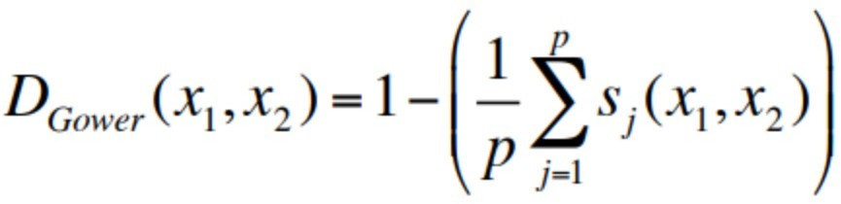
GOWER DISTANCE
Gower distance (for mixed attributes, categorical and quantitative)
Computed as the average of partial dissimilarities across individuals

Slide 7
CORRELATION VS COSINE VS EUCLIDEAN DISTANCE
Compare the three proximity measures according to their behavior under variable transformation
scaling: multiplication by a value
translation: adding a constant
Property | Cosine | Correlation | Euclidean Distance
Invariant to scaling (multiplication) | Yes | Yes | No
Invariant to translation (addition) | No | Yes | No
Notes:
Scaling changes magnitude not direction and preserves position and relationship.
Cosine and corr compute sim/dissim based on direction or linera r/p while Euclidean computes using magntiude

Slide 8
CORRELATION VS COSINE VS EUCLIDEAN DISTANCE
Property | Cosine | Correlation | Euclidean Distance
Invariant to scaling (multiplication) | Yes | Yes | No
Invariant to translation (addition) | No | Yes | No
Consider the example
x = (1, 2, 4, 3, 0, 0, 0), y = (1, 2, 3, 4, 0, 0, 0)
y_{s} = y * 2 (scaled version of y),
y_{t} = y + 5 (translated version)
Measure | (x , y) | (x , y_{s}) | (x , y_{t})
Cosine | 0.9667 | 0.9667 | 0.7940
Correlation | 0.9429 | 0.9429 | 0.9429
Euclidean Distance | 1.4142 | 5.8310 | 14.2127

Slide 9
CLUSTERING
UNSUPERVISED LEARNING

Slide 10
WHAT IS CLUSTER ANALYSIS?
Given a set of objects, place them in groups such that the objects in a group are similar (or related) to one another and different from (or unrelated to) the objects in other groups
Intra-cluster distances are minimized
Inter-cluster distances are maximized

Slide 11
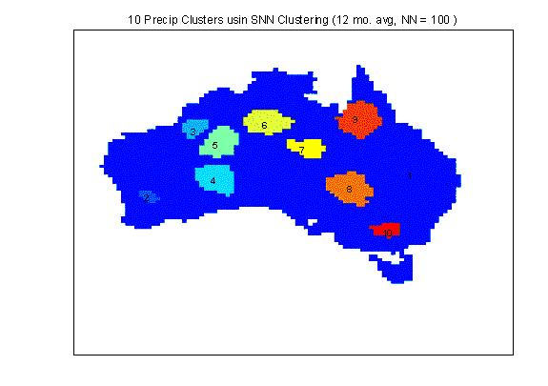
APPLICATIONS OF CLUSTER ANALYSIS
Understanding
Group related documents for browsing, group genes and proteins that have similar functionality, or group stocks with similar price fluctuations
Summarization
Reduce the size of large data sets`
Clustering precipitation in Australia

Slide 12
WHAT IS CLUSTER ANALYSIS?
Cluster: A collection of data objects
similar (or related) to one another within the same group
dissimilar (or unrelated) to the objects in other groups
Cluster analysis (or clustering, data segmentation, …)
Finding similarities between data according to the characteristics found in the data and grouping similar data objects into clusters
Unsupervised learning: no predefined classes (i.e., learning by observations vs. learning by examples: supervised)
Typical applications
As a stand-alone tool to get insight into data distribution
As a preprocessing step for other algorithms

Slide 13
CLUSTERING FOR DATA UNDERSTANDING AND APPLICATIONS
Biology: taxonomy of living things: kingdom, phylum, class, order, family, genus and species
Information retrieval: document clustering
Land use: Identification of areas of similar land use in an earth observation database
Marketing: Help marketers discover distinct groups in their customer bases, and then use this knowledge to develop targeted marketing programs
City-planning: Identifying groups of houses according to their house type, value, and geographical location
Earth-quake studies: Observed earth-quake epicenters should be clustered along continent faults
Climate: understanding earth climate, find patterns of atmospheric and ocean
Economic Science: market research

Slide 14
CLUSTERING AS A PREPROCESSING TOOL (UTILITY)
Summarization:
Preprocessing for regression, PCA, classification, and association analysis
Compression:
Image processing: vector quantization
Finding K-nearest Neighbors
Localizing search to one or a small number of clusters
Outlier detection
Outliers are often viewed as those “far away” from any cluster

Slide 15
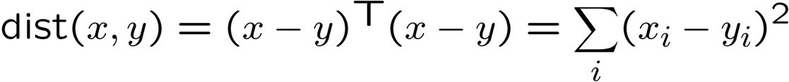
CLUSTERING
Basic idea: group together similar instances
Example: 2D point patterns
What could “similar” mean?
One option: small (squared) Euclidean distance
Clustering results are crucially dependent on the measure of similarity (or distance) between “points” to be clustered

Slide 16







NOTION OF A CLUSTER CAN BE AMBIGUOUS
How many clusters?
Six Clusters
Four Clusters
Two Clusters

Slide 17
TYPES OF CLUSTERING
A clustering is a set of clusters
Important distinction between hierarchical and partitional sets of clusters
Partitional Clustering
A division of data objects into non-overlapping subsets (clusters)
Hierarchical Clustering
A set of nested clusters organized as a hierarchical tree

Slide 18
PARTITIONAL CLUSTERING
Original Points
A Partitional Clustering

Slide 19
HIERARCHICAL CLUSTERING
p1
p3 p4
p2
Traditional Hierarchical Clustering
p1 p2 p3 p4
Traditional Dendrogram
p1
p3 p4
p2
p1 p2 p3 p4
Non-traditional Dendrogram
Non-traditional Hierarchical Clustering

Slide 20
OTHER DISTINCTIONS BETWEEN SETS OF CLUSTERS
Exclusive versus non-exclusive
In non-exclusive clustering, points may belong to multiple clusters.
Can belong to multiple classes or could be ‘border’ points
Fuzzy clustering (one type of non-exclusive)
In fuzzy clustering, a point belongs to every cluster with some weight between 0 and 1
Weights must sum to 1
Probabilistic clustering has similar characteristics
Partial versus complete
In some cases, we only want to cluster some of the data

Slide 21
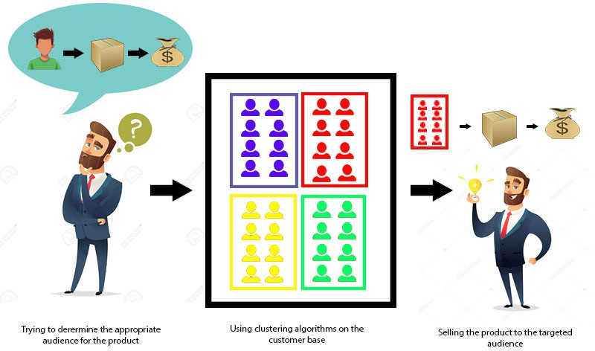
CLUSTERING EXAMPLES
Clustering Customers to target the right group for a product
https://static.javatpoint.com/tutorial/data-mining/images/data-mining-cluster-analysis.jpg

Slide 22
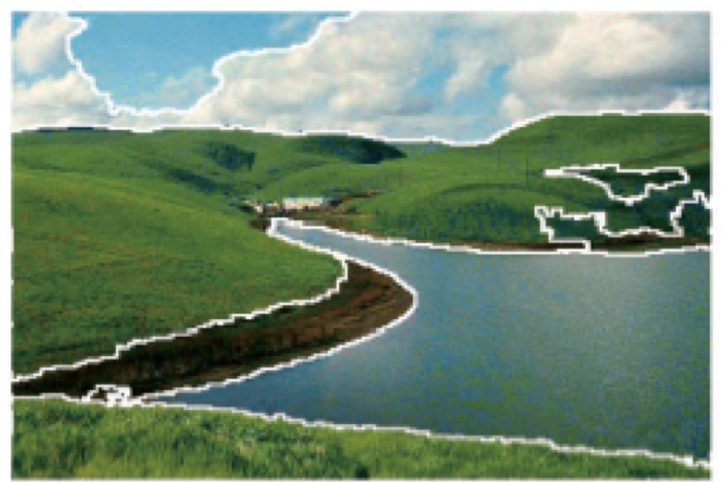
CLUSTERING EXAMPLES
Image segmentation
Goal: Break up the image into meaningful or perceptually similar regions
[Slide from James Hayes]

Slide 23
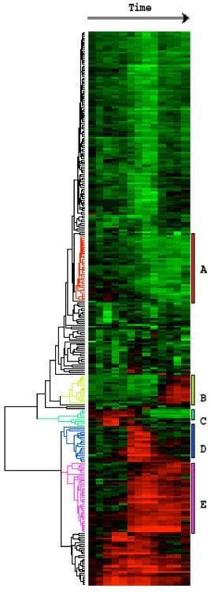
CLUSTERING EXAMPLES
Clustering Gene expression data
Eisen et al, PNAS 1998

Slide 24
TYPES OF CLUSTERS
Well-separated clusters
Prototype-based clusters
Contiguity-based clusters
Density-based clusters
Described by an Objective Function

Slide 25
TYPES OF CLUSTERS:WELL-SEPARATED
Well-Separated Clusters:
A cluster is a set of points such that any point in a cluster is closer (or more similar) to every other point in the cluster than to any point not in the cluster.
3 well-separated clusters

Slide 26
TYPES OF CLUSTERS: PROTOTYPE-BASED
Prototype-based
A cluster is a set of objects such that an object in a cluster is closer (more similar) to the prototype or “center” of a cluster, than to the center of any other cluster
The center of a cluster is often a centroid, the average of all the points in the cluster, or a medoid, the most “representative” point of a cluster
4 center-based clusters

Slide 27

TYPES OF CLUSTERS: CONTIGUITY-BASED
Contiguous Cluster (Nearest neighbor or Transitive)
A cluster is a set of points such that a point in a cluster is closer (or more similar) to one or more other points in the cluster than to any point not in the cluster.
8 contiguous clusters

Slide 28



TYPES OF CLUSTERS: DENSITY-BASED
Density-based
A cluster is a dense region of points, which is separated by low-density regions, from other regions of high density.
Used when the clusters are irregular or intertwined, and when noise and outliers are present.
6 density-based clusters

Slide 29
QUALITY:WHAT IS GOOD CLUSTERING?
A good clustering method will produce high quality clusters
high intra-class similarity: cohesive within clusters
low inter-class similarity: distinctive between clusters
The quality of a clustering method depends on
the similarity measure used by the method
its implementation, and
Its ability to discover some or all of the hidden patterns

Slide 30
MEASURE THE QUALITY OF CLUSTERING
Dissimilarity/Similarity metric
Similarity is expressed in terms of a distance function, typically metric:
d(i, j)
The definitions of distance functions are usually rather different for interval-scaled, boolean, categorical, ordinal ratio, and vector variables
Weights should be associated with different variables based on applications and data semantics
Quality of clustering:
There is usually a separate “quality” function that measures the “goodness” of a cluster.
It is hard to define “similar enough” or “good enough”
The answer is typically highly subjective

Slide 31
CONSIDERATIONS FOR CLUSTER ANALYSIS
Partitioning criteria
Single level vs. hierarchical partitioning (often, multi-level hierarchical partitioning is desirable)
Separation of clusters
Exclusive (e.g., one customer belongs to only one region) vs. non-exclusive (e.g., one document may belong to more than one class)
Similarity measure
Distance-based (e.g., Euclidian, road network, vector) vs. connectivity-based (e.g., density or contiguity)
Clustering space
Full space (often when low dimensional) vs. subspaces (often in high-dimensional clustering)

Slide 32
REQUIREMENTS AND CHALLENGES
Scalability
Clustering all the data instead of only on samples
Ability to deal with different types of attributes
Numerical, binary, categorical, ordinal, linked, and mixture of these
Constraint-based clustering
User may give inputs on constraints
Use domain knowledge to determine input parameters
Interpretability and usability
Others
Discovery of clusters with arbitrary shape
Ability to deal with noisy data
Incremental clustering and insensitivity to input order
High dimensionality

Slide 33
MAJOR CLUSTERING APPROACHES (I)
Partitioning approach:
Construct various partitions and then evaluate them by some criterion, e.g., minimizing the sum of square errors
Typical methods: k-means, k-medoids, CLARANS
Hierarchical approach:
Create a hierarchical decomposition of the set of data (or objects) using some criterion
Typical methods: Diana, Agnes, BIRCH, CAMELEON
Density-based approach:
Based on connectivity and density functions
Typical methods: DBSACN, OPTICS, DenClue
Grid-based approach:
based on a multiple-level granularity structure
Typical methods: STING,WaveCluster, CLIQUE

Slide 34
MAJOR CLUSTERING APPROACHES (II)
Model-based:
A model is hypothesized for each of the clusters and tries to find the best fit of that model to each other
Typical methods: EM, SOM, COBWEB
Frequent pattern-based:
Based on the analysis of frequent patterns
Typical methods: p-Cluster
User-guided or constraint-based:
Clustering by considering user-specified or application-specific constraints
Typical methods: COD (obstacles), constrained clustering
Link-based clustering:
Objects are often linked together in various ways
Massive links can be used to cluster objects: SimRank, LinkClus

Slide 35
READING MATERIAL
Chapter 2 & 8:Tan, Steinbach & Kumar
Chapter 2 & 10: Han, Kamber & Pei
An article on distance measures:
https://towardsdatascience.com/17-types-of-similarity-and-dissimilarity-measures-used- in-data-science-3eb914d2681

